Slide 1
SC2001 Project 1(Group 4)
Group Members:
Sean Tan U2240611G
Tan Kai Jie, Daryl U2210031J
Phua Guan Yuan U2240642C
Programming language used: Python

Slide 2
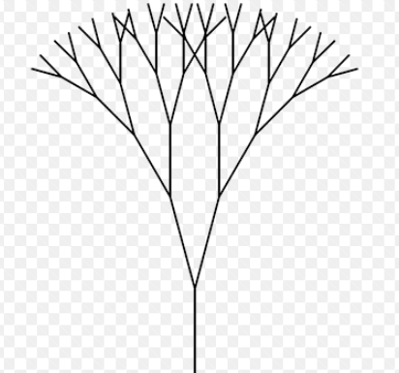
(a) Implement the above hybrid algorithm
『if the array has reduced to a size less than S, run insertion sort. This is somewhat like the base case of the algorithm.』
『split the array into halves, to proceed to use merge sort』
『merge function helps to combine data received from insertion sort and merge sort into one array』

Slide 3
(a) Implement the above hybrid algorithm
def merge(left_half, right_half):
global comparison_count
merged = []
i = j = 0
while i < len(left_half) and j < len(right_half):
comparison_count += 1
if left_half[i] < right_half[j]:
merged.append(left_half[i])
i += 1
else:
merged.append(right_half[j])
j += 1
merged.extend(left_half[i:])
merged.extend(right_half[j:])
return merged
def insertion_sort(array):
global comparison_count
n = len(array)
for i in range(1, n):
j = i
while j > 0:
comparison_count += 1
if array[j] < array[j - 1]:
array[j], array[j - 1] = array[j - 1], array[j]
else:
break
j -= 1
return array
def hybrid_sort(arr, s): if len(arr) <= s: return insertion_sort(arr) mid = len(arr) // 2 left_half = arr[:mid] right_half = arr[mid:] left_half = hybrid_sort(left_half, s) right_half = hybrid_sort(right_half, s) return merge(left_half, right_half)

Slide 4
(b) Generate arrays of increasing sizes, in a range from 1,000 to 10 million. For each of the sizes, generate a random dataset of integers in the range of [1, …, x], where x is the largest number you allow for your datasets.
sizes = np.linspace(1000, 10000000, 25).astype(int)
x = 10000000
arrays = {}
for size in sizes:
random_array = np.random.randint(1,x,int(size))
arrays[size] = random_array
『generate 25 datasets where the sizes are equally spaced from 1,000 to 10,000,000』
『 maximum data value set for each dataset』
『 create a dictionary; key means size, value means dataset』
『Create a temporary array of random values, ranging from 1 to 10,000,000』
『Insert temporary array into dictionary as value』

Slide 5


Theoretical Analysis (Best Case)
n = size of original array
s = size of sub-array for insertion sort
Number of times algorithm divided till the value of S :
Best case time complexity:
Insertion sort takes O(s) time in this case, as the array to be sorted by insertion sort is already sorted (best case). Hence there are n/s number of times that insertion sort happens. The divide and conquer algorithm takes nlogn time normally. However , it does the algorithm n/s times before switching to insertion sort. Hence the time complexity is nlog(n/s).

Slide 6

Theoretical Analysis (Worst Case)
n = size of original array
s = size of sub-array for insertion sort
Worst case time complexity:
Insertion sort takes O(s^2) time in this case, as the array to be sorted by insertion sort is in the worst case. Time complexity for merge sort is not affected by the arrangement of values in the dataset.
Average case time complexity:
The average case time complexity is the same as worst case, as for both average time complexities for insertion sort and merge sort, their average case complexity is the same as their respective worst cases.

Slide 7


Theoretical Analysis (Overall)
If we take the value of s to be small,
Hence,
Overall time complexity:

Slide 8
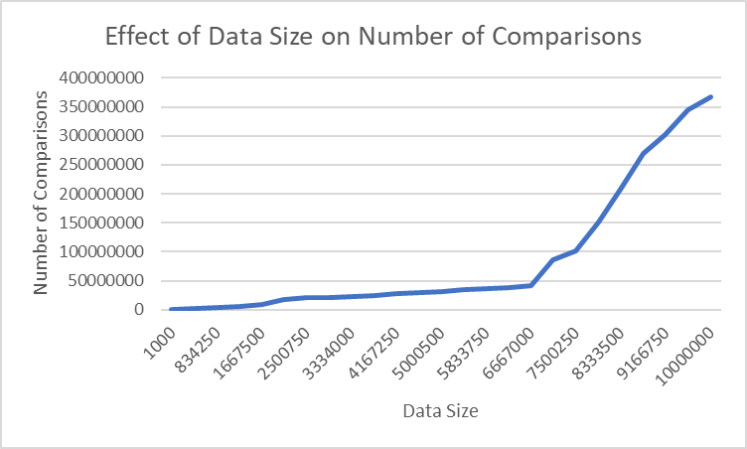
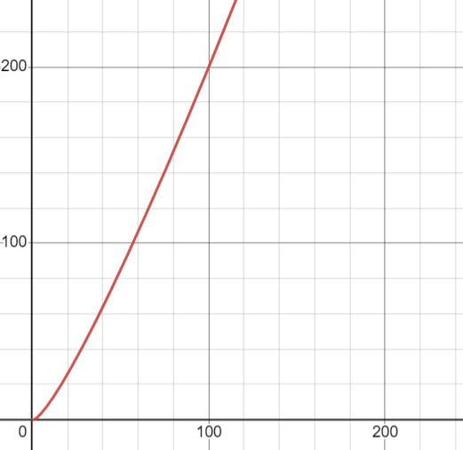
(Ci) With the value of S fixed, plot the number of key comparisons over different sizes of the input list n. Compare your empirical results with your theoretical analysis of the time complexity.
With the fixed S value = 124,
Number of key comparisons increases as the size of the input list increases.
Consistent with our theoretical analysis
Number of key comparisons corresponds to time taken
Increasing number of key comparisons suggest longer time taken
nlog(n) increases as n increases
n log(n) graph

Slide 9
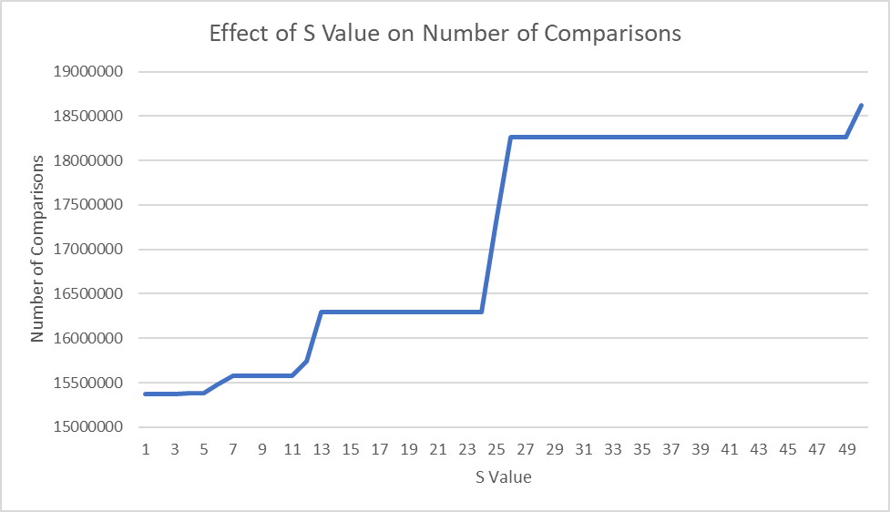


(Cii) With the input size n fixed, plot the number of key comparisons over different values of S. Compare your empirical results with your theoretical analysis of the time complexity.
With the fixed dataset size = 834 250,
Number of key comparisons increases as the size of the input list S value increases.
Consistent with our theoretical analysis for large values of S
Number of key comparisons corresponds to time taken
Increasing number of key comparisons suggest longer time taken
For large values of S
(Worse time complexity)
For small values of S:
(Better time complexity)

Slide 10
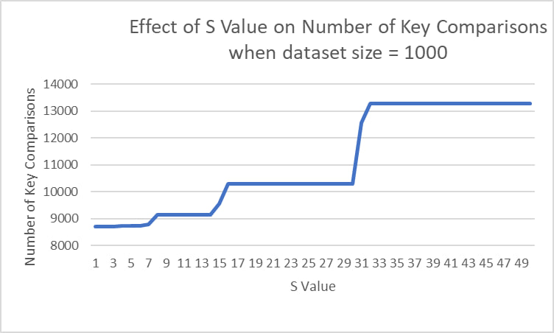
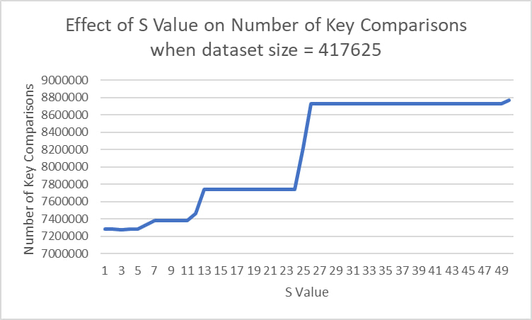
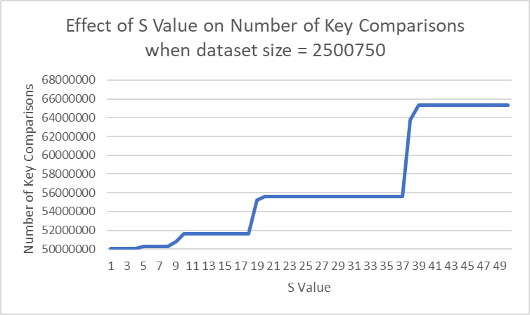
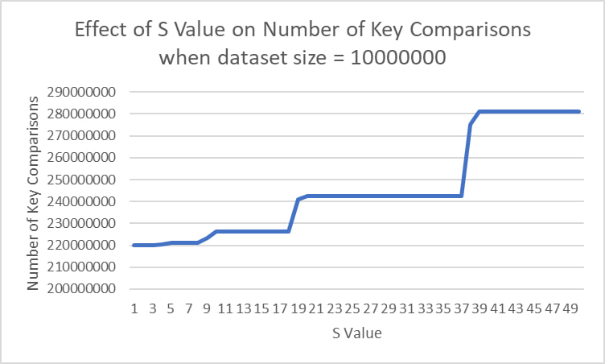
(Ciii) Using different sizes of input datasets, study how to determine an optimal value of S for the best performance of this hybrid algorithm
Optimal S Value for :
Dataset size 1000 = 14
Dataset size 417625 = 13
Dataset size 2500750 = 18
Dataset size 10000000 = 18
…
Taking the average optimal S values for 25 datasets,
Optimal S Value is 16.
14
13
18
18

Slide 11
(d) Compare with original Mergesort: Implement the original version of Mergesort (as learnt in lecture). Compare its performance against the above hybrid algorithm in terms of the number of key comparisons and CPU times on the dataset with 10 million integers. You can use the optimal value of S obtained in (c) for this task.
From the results, we observe that for the optimal value of S = 16:
HybridSort Perfomance:
Key Comparisons = 226410794
Time taken = 58.32036256790161 s
MergeSort Perfomance:
Key Comparisons = 167730498
Time taken = 65.36337566375732 s
We see that HybridSort performs 10.8% faster than MergeSort in terms of the time taken to sort the array.
However, HybridSort does 34.9% more number of key comparisons than mergesort.

Slide 12
THANK YOU

